Slide 1
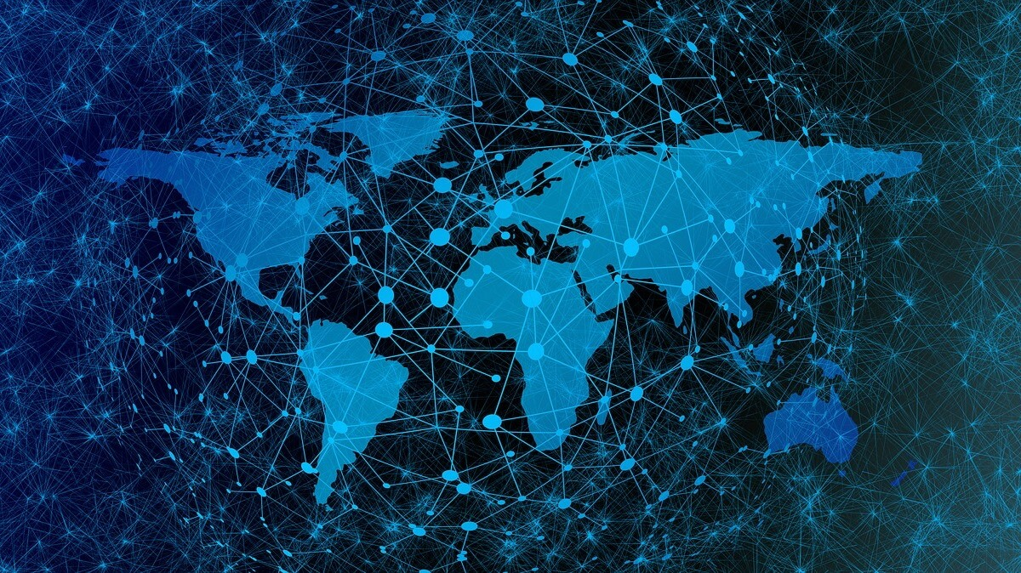
The Global Digital Divide
An analysis of internet usage across the world

Slide 2
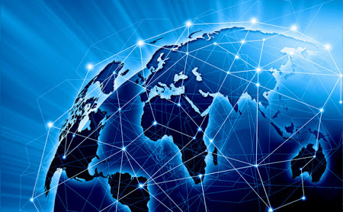
Table of contents
Motivations & Sources
Process summary
Analysis & Findings
Conclusions & Limitations

Slide 3

Motivations & Sources

Slide 4
Motivations & Sources
Motivation
The objective of this project is to analyse global disparities in regards to access to the internet and the opportunities derived from such access.
Our motivation is summarized by the words of the inventor of the World Wide Web, Sir Tim Berners-Lee:
“It’s time to recognise the Internet as a basic human right. That means guaranteeing affordable access for all, ensuring Internet packets are delivered without commercial or political discrimination, and protecting the privacy and freedom of Web users regardless of where they live.”
Sir Tim Berners-Lee

Slide 5




Motivations & Sources
Universal Access
Freedom & Openness
Relevant Content
Empowerment
This criteria measures the level of communications infrastructure available in each country as well as the level of affordability and education and awareness of such facilities.
This criteria measures the level of restrictions to internet accessibility as well as freedom of speech and privacy laws in the online world.
This criteria measures the level of information and government online facilities made for the people by the people in their own language to improve lives and living standards.
This criteria measures the economic, political, social and environmental impact of internet use in each country particularly in improving healthcare, education and economic opportunities

Slide 6
Motivations & Sources
Sources of Information
Internet World Stats
Web index
Compare the market
The Web Index is a multi-dimensional measure of the World Wide Web's contribution to development and human rights globally. It covers 86 countries as of 2014, the latest year for which the index has been compiled. It incorporates indicators that assess the areas of universal access, freedom and openness, relevant content, and empowerment, which indicate economic, social, and political impacts of the Web.
(https://www.comparethemarket.com/broadband/content/global-broadband-index)
(https://thewebindex.org)
This website provides information on cost and speed of internet by countries.
(https://www.internetworldstats.com/stats1.html)
This website provides information on internet users by country and region across the globe.
(https://datahelpdesk.worldbank.org/knowledgebase/topics/125589-developer-information)
World bank API
This website provides information on latitude and longitude by country to support visualizations .

Slide 7
Process Summary

Slide 8



Process Summary
1. Web
2. Extract
3. Transform/Load
Pandas
+ Json
Csv files
PG Admin
-SQL-
()
6. Web Design
5. Data Source
4. Flask App
Anna
Flask + SQLAlchemy

Slide 9
Analysis & findings

Slide 10
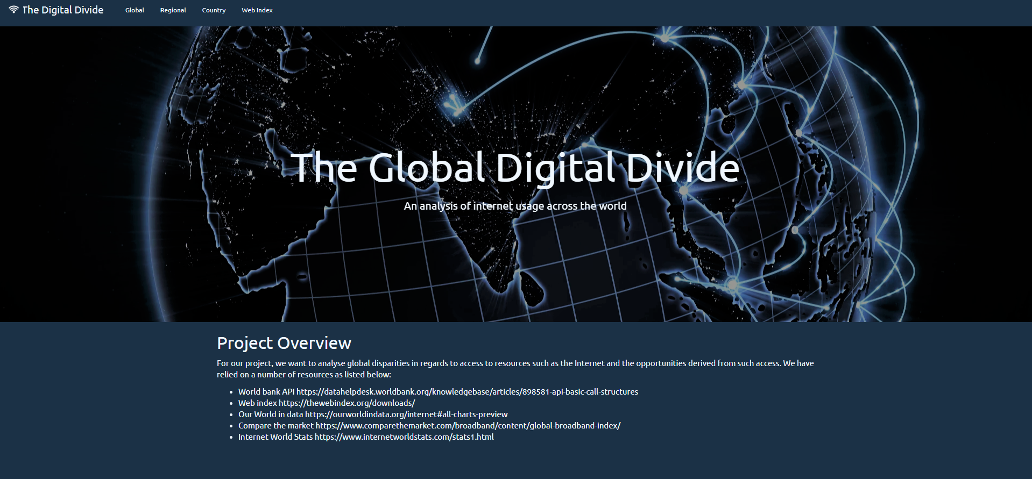
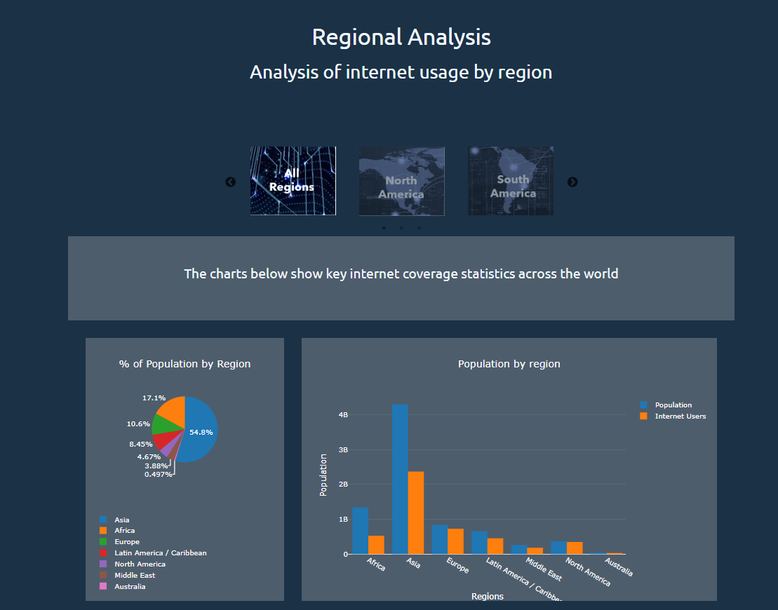
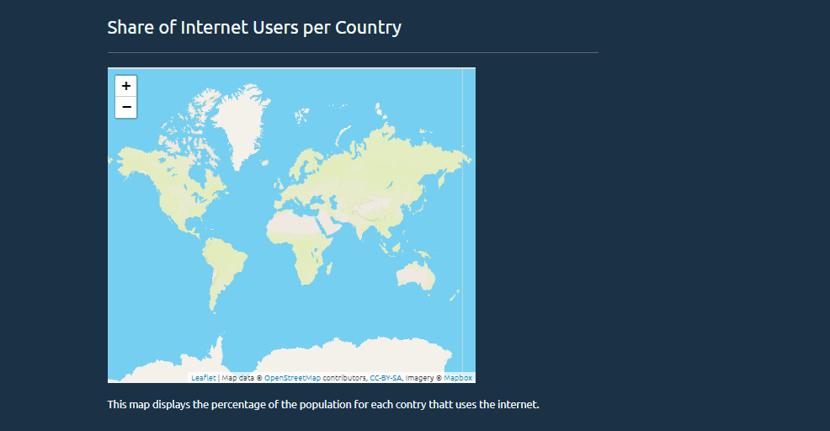
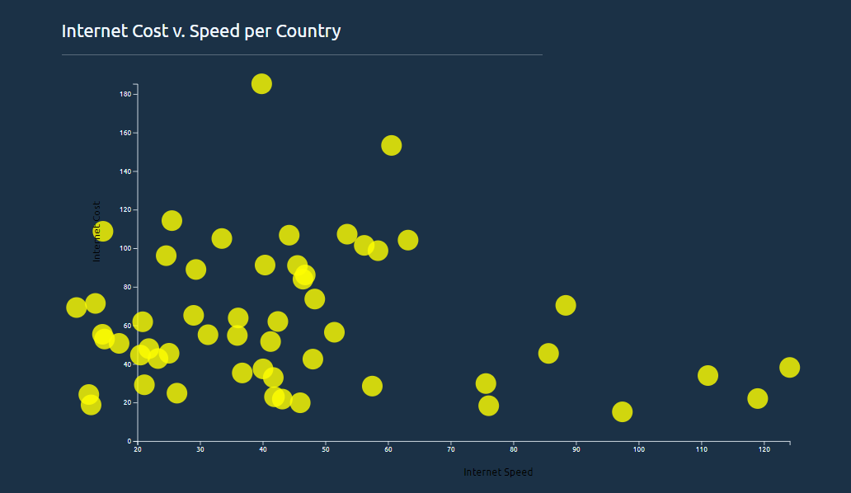
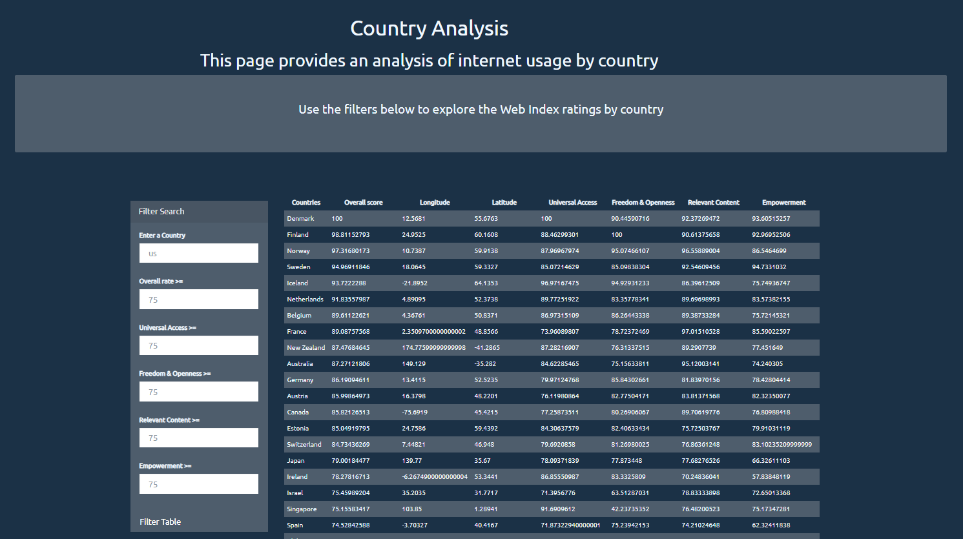
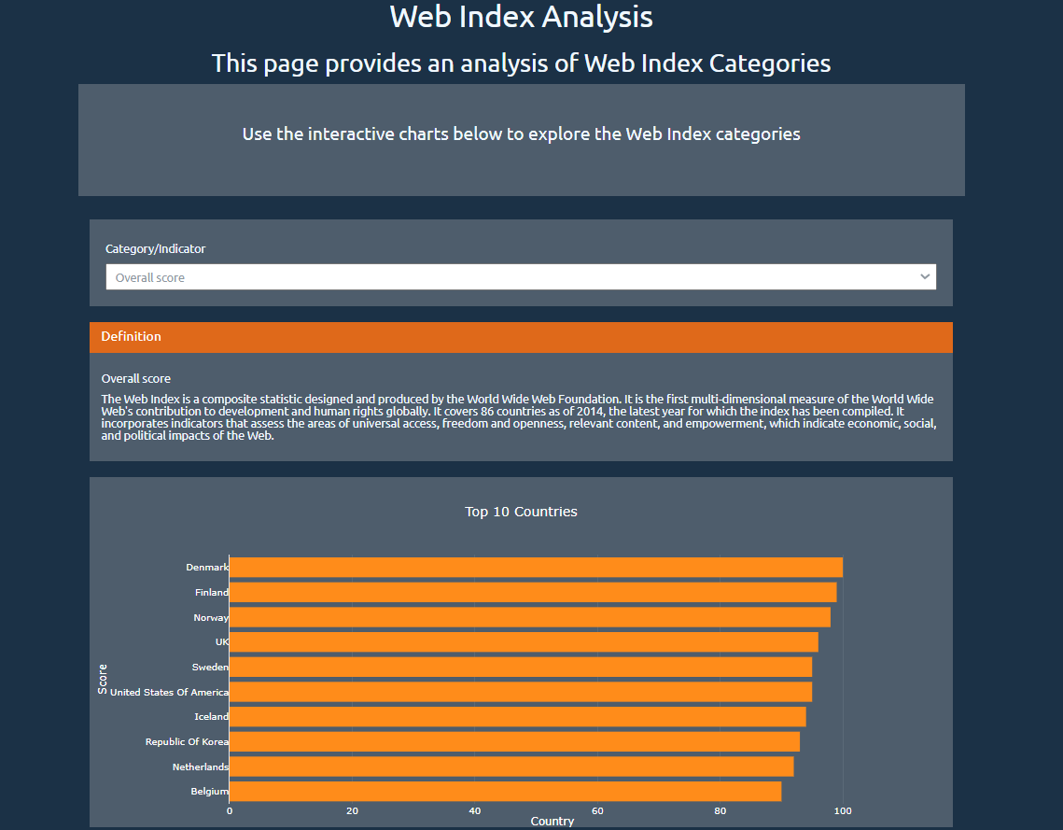
Analysis & findings
The following dashboards provide a visual analysis on a global, regional and country by country level as well as by Web Index Category.
Global Analysis

Slide 11
Conclusions & further research

Slide 12
Conclusions & further research

Slide 13
Thank you!
Q&A

